Slide 1
RNS Institute of Technology Department of Information Science and Engineering
DESIGN AND ANALYSIS OF ALGORITHMS LABORATORY
(18CSL47)
TITLE : 8-PUZZLE PROBLEM USING LEAST COST BRANCH AND BOUND
Staff in Charge: Mrs. Kusuma R Carried out by:
Designation: Assistant Professor
Hemath Kumar M(1RN19IS063)
Karthik raj R (1RN19IS068)
Chinmay Hegde(1RN19IS053)

Slide 2

CONTENTS
ABSTRACT
INTRODUCTION
OBJECTIVE OF THE PROJECT
ALGORITHM DESIGN TECHNIQUE
PROJECT ARCHITECTURE
IMPLEMENTATION MODULES
RESULTS
DIFFERENT TECHNIQUES TO SOLVE 8-PUZZLE PROBLEM
RESULTS
APPLICATIONS
CONCLUSION AND FUTURE ENHANCEMENTS
REFERENCES

Slide 3
ABSTRACT
We’ve designed a 8-puzzle problem using Branch and Bound to solve the puzzle.
In this we find the minimum number of steps to solve the initial scrambled 8-puzzle and get the solved puzzle.
We’re going to take you through the project layout wherein you’ll see the construction, objective and purpose of the project…
Here’s the complete outlook of the project.

Slide 4
INTRODUCTION
Given a 3×3 board with 8 tiles (every tile has one number from 1 to 8) and one empty space.
The objective is to place the numbers on tiles to match the final configuration using the empty space.
Here we can slide four adjacent (left, right, above, and below) tiles into the empty space.

Slide 5
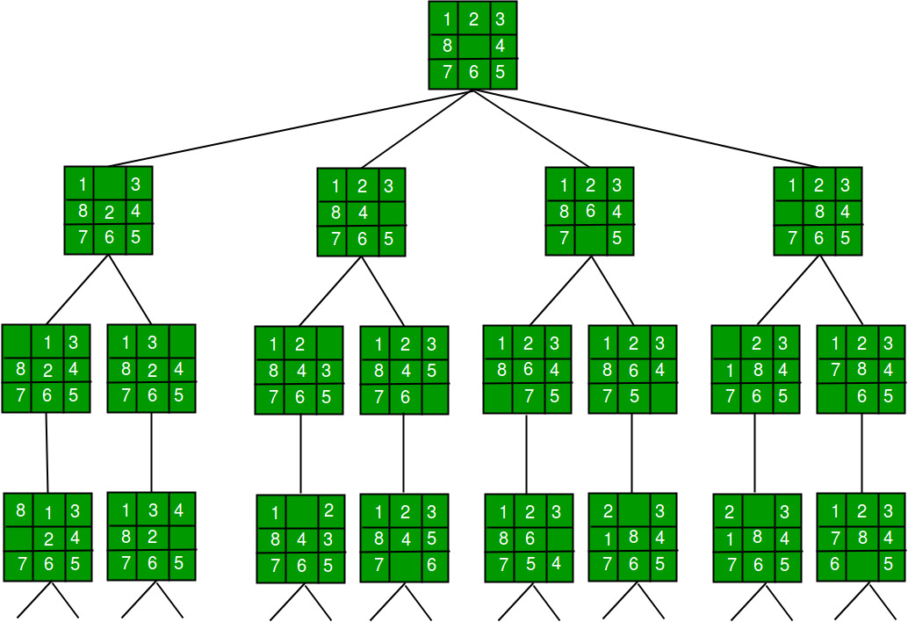
INTRODUCTION
We use the least cost branch and bound technique to solve this problem.
Here, we create partial solutions of the possible moves and select the partial-solution with the least amount of unordered blocks at each level of branching until the base configuration is achieved.

Slide 6
OBJECTIVE
The objective of this project is that it gives the sequence of steps needed to find the base configuration when a given jumbled sequence is given as a problem.
Least Cost Branch and Bound helps was to achieve this with minimum number of steps.

Slide 7
ALGORITHM DESIGN TECHNIQUE
BRANCH AND BOUND
The search for an answer node can often be speeded by using an “intelligent” ranking function, also called an approximate cost function to avoid searching in sub-trees that do not contain an answer node. It is similar to the backtracking technique but uses a BFS-like search.r an
The least cost Brand and Bound algorithm helps us delete the unwanted partial solutions created and select the best optimized solution at each level of state space tree.
We obtain the solution with least number of steps and also obtain it quicker.

Slide 8
PROJECT ARCHITECTURE
There are basically three types of nodes involved in Branch and Bound 1. Live node is a node that has been generated but whose children have not yet been generated. 2. E-node is a live node whose children are currently being explored. In other words, an E-node is a node currently being expanded. 3. Dead node is a generated node that is not to be expanded or explored any further. All children of a dead node have already been expanded.
The ideal Cost function for an 8-puzzle Algorithm : We assume that moving one tile in any direction will have a 1 unit cost. Keeping that in mind, we define a cost function for the 8-puzzle algorithm as below:
c(x) = f(x) + h(x)
where f(x) is the length of the path from root to x ( number of moves so far)
h(x) is the number of non-blank tiles not in in their goal position (number of mis-placed
tiles).
There are at least h(x) moves to transform state x to a goal state .

Slide 9
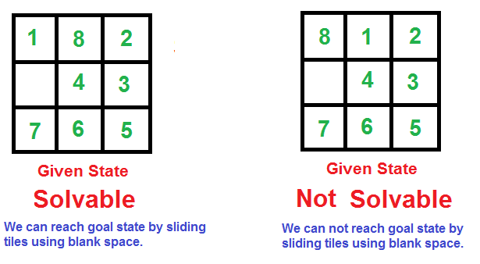
CHECKINg for SOLVABILITY OF PUZZLE :
→ Solvable input : → Not Solvable input:
1 has no inversion 8 has 7inversions
8 has 6 inversions 1 has no inversions
2 has no inversions 2 has no inversions
4 has 1 inversion 4 has 1 inversion
3 has no inversions 3 has no inversions
7 has 2 inversions 7 has 2 inversions
6 has 1 inversion 6 has 1 inversion
5 has no inversions 5 has no inversions
TOTAL INVERSIONS = 10 TOTAL INVERSIONS = 11
It is solvable only is it has even number of inversions.
What is inversion? A pair of tiles form an inversion if the values on tiles are in reverse order of their appearance in goal state.

Slide 10
COMPLETE ALGORITHM
/* Algorithm LCSearch uses c(x) to find an answer node
* LCSearch uses Least() and Add() to maintain the list
of live nodes
* Least() finds a live node with least c(x), deletes
it from the list and returns it
* Add(x) adds x to the list of live nodes
* Implement list of live nodes as a min-heap */
Class list_node
{
list_node *next;
// Helps in tracing path when answer is found
list_node *parent;
float cost;
}
Algorithm LCSearch(list_node *t)
{
// Search t for an answer node
// Input: Root node of tree t
// Output: Path from answer node to root
if (*t is an answer node)
{
print(*t);
return;
}
E = t; // E-node
Initialize the list of live nodes to be empty;
while (true)
{

Slide 11
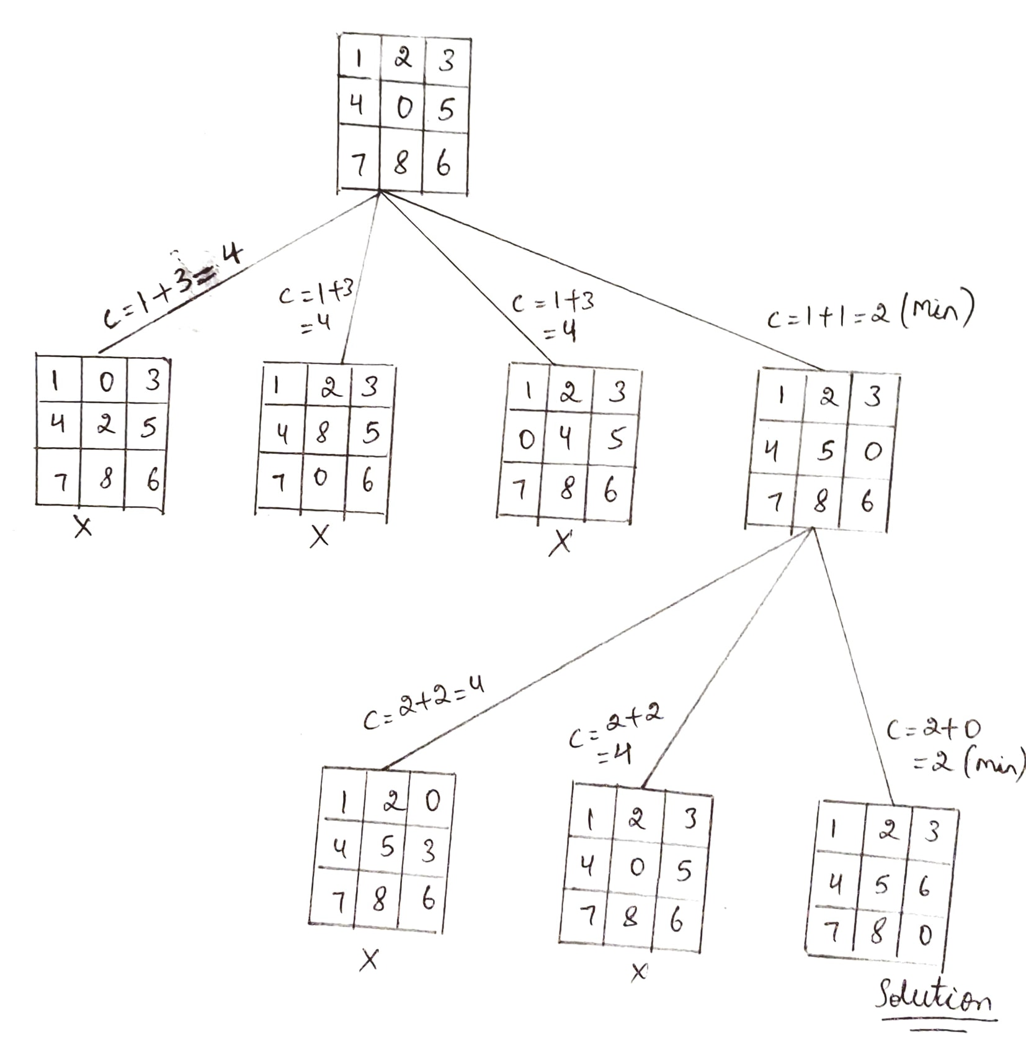
for each child x of E
{
if x is an answer node
{
print the path from x to t;
return;
}
Add (x); // Add x to list of live nodes;
x->parent = E; // Pointer for path to root
}
if there are no more live nodes
{
print ("No answer node");
return;
}
// Find a live node with least estimated cost
E = Least();
// The found node is deleted from the list of
// live nodes
}
}
The state space tree shows the least code Branch and Bound
technique.
At each level ,the node x with least cost is chosen as E-node
and other nodes become dead.

Slide 12
IMPLEMENTATION MODULES

Slide 13
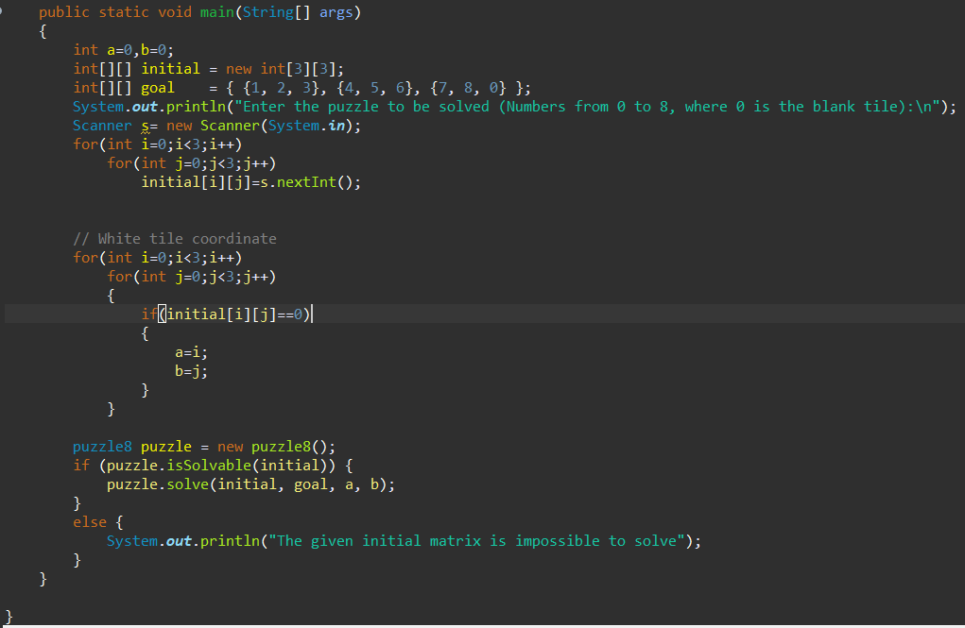
Main Function
The main function takes user input , i.e the initial scrambled matrix.
Then it checks whether the given puzzle is solvable or not.
If it’s solvable , then the main function implements all the functions to give the steps to solve the problem.

Slide 14
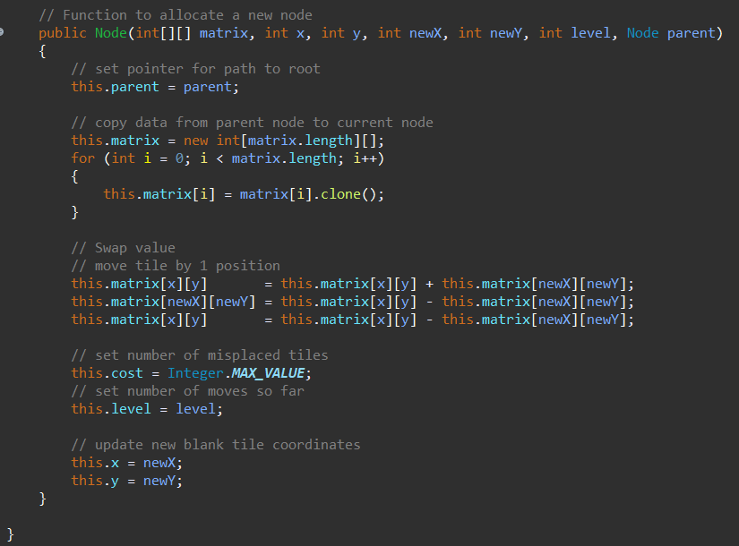
Function To Allocate New Node
This is a Constructor of class Node helps in setting pointer to the parent node when branching takes place at each level.
When branching occurs , a clone of the parent is created.
The tile co-ordinates of this matrix is modified according to the moves implemented.
Hence it updates the new tile co-ordinates.
It also sets the level of the node.

Slide 15
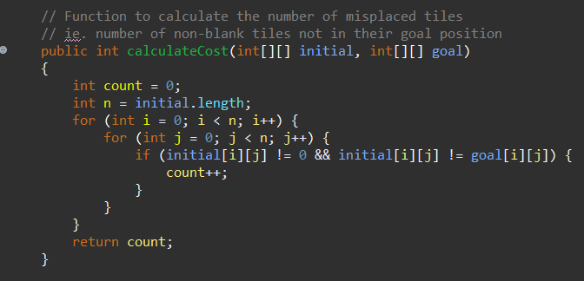
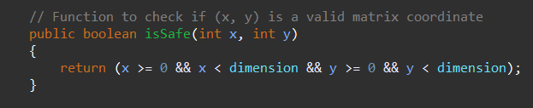
“calculateCost” is a function that calculates the number of misplaced tiles in the considered node.
“isSafe” is a Boolean function that tells if the tile co-ordinates of a node are valid or not.

Slide 16
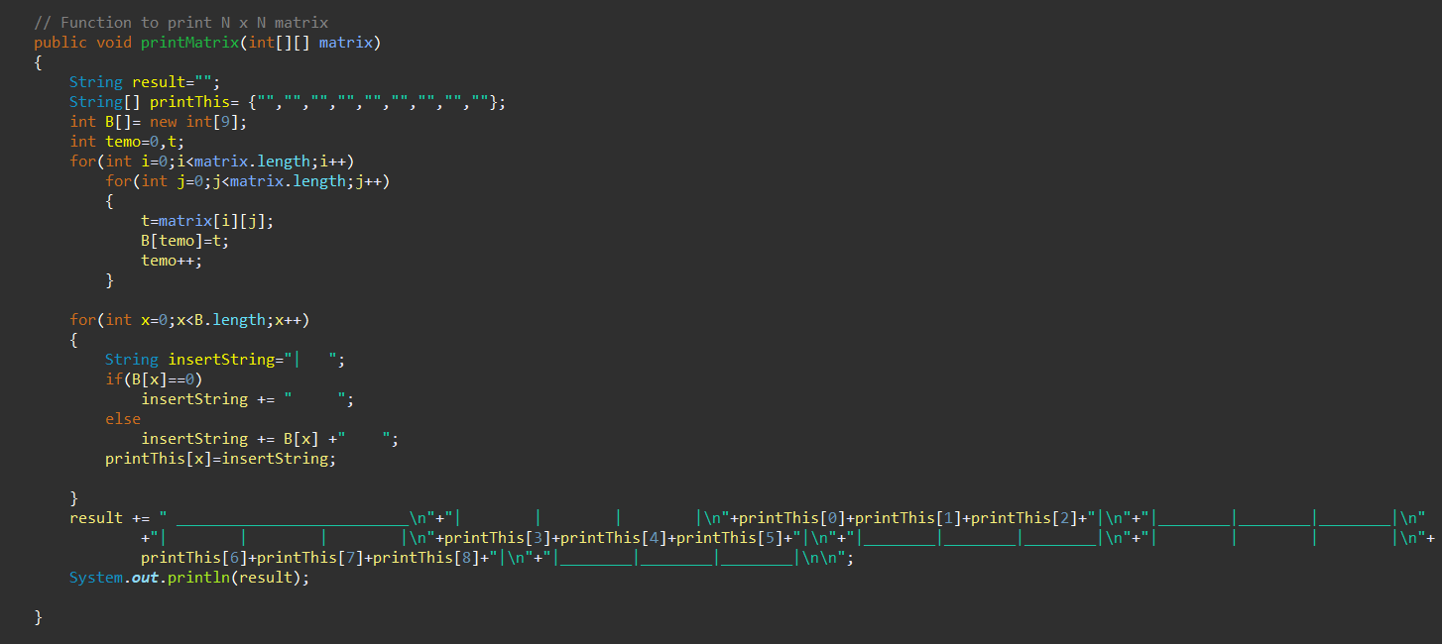
This function prints each of the solution matrices from the initial input node to the goal node step by step (through each levels).
It prints the tile co-ordinates in such a way that it displays it inside a box with 3*3 tiles.

Slide 17
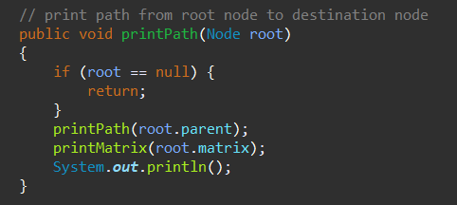
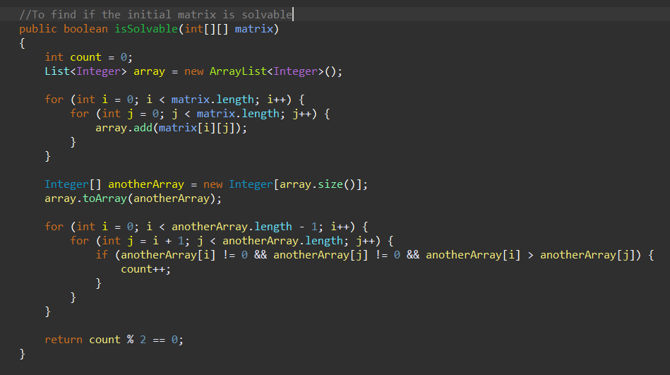
“printhPath” function recursively iterates from the goal node found to the initial node and prints all the solution nodes one by one in the order of their moves.
“isSolvable” function calculates the total number of inversions by setting up a counter . If the count is even , it’s a solvable puzzle else not solvable.

Slide 18
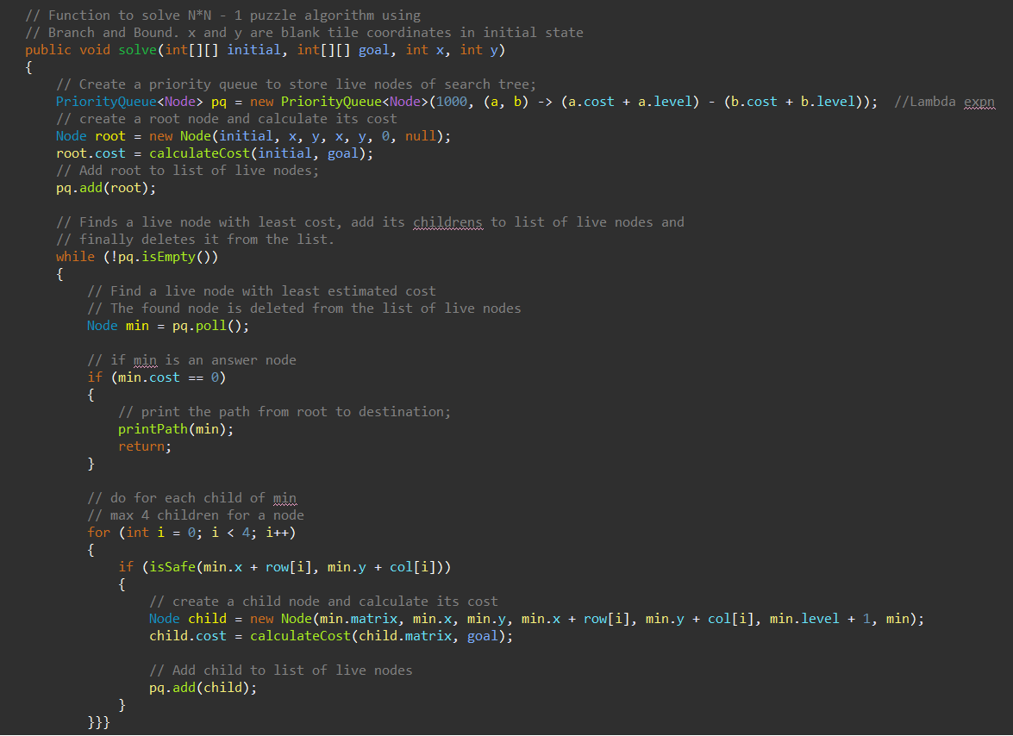
Function Sets Up A Priority Queue

Slide 19
Then a live node with least cost is found and it’s children are added to the list of live nodes and gradually deleted from the list.
This ultimately results in the goal node being found and then the “printPath” function is called to print the solution matrices step by step.
It also checks if the co-ordinates of the child node created are valid or not by calling the “isSafe” function and assigns the cost for the child node and adds it to the priority queue.

Slide 20

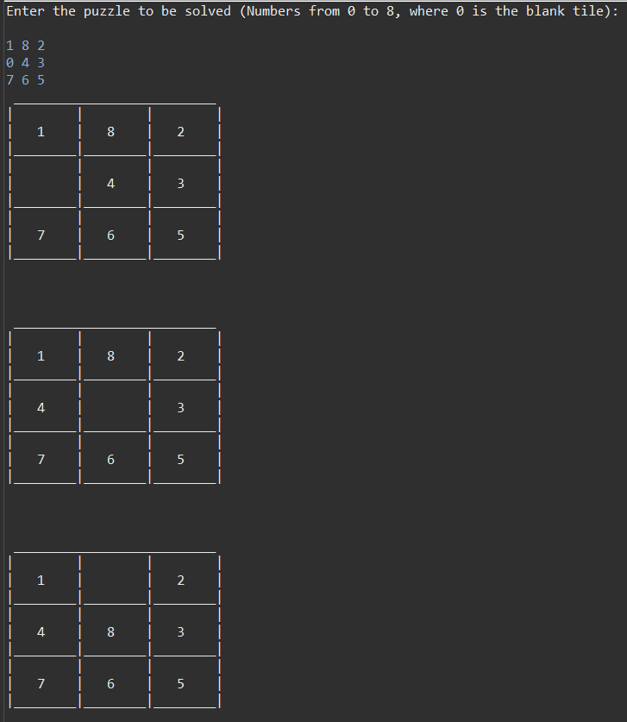
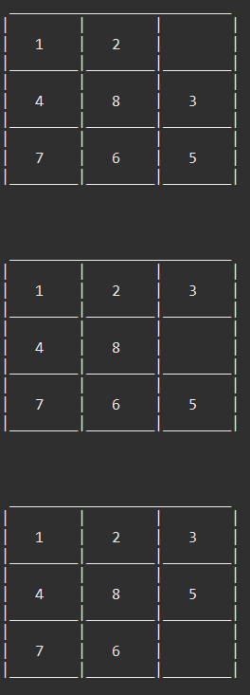
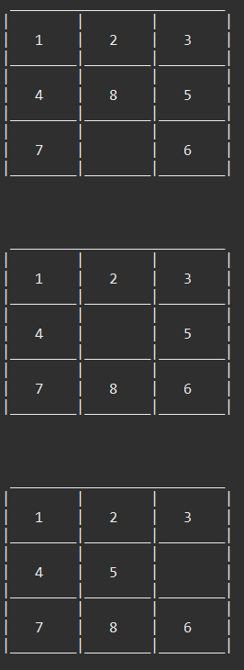
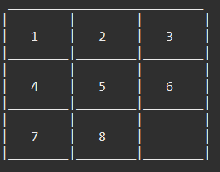
RESULT(Solvable)

Slide 21
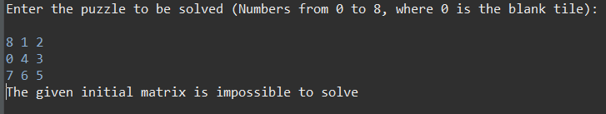
RESULT(Not-Solvable)
This input has 11 inversions which is odd hence it is not solvable

Slide 22
DIFFERENT ALGORITHM TECHNIQUES TO SOLVE 8-PUZZLE PROBLEM
FIFO and LIFO Branch and Bound techniques maybe used but they consumes more time and space.
DFS and BFS Brute-Force.
A*Search technique.
Heuristic(Informed Search) in AI.

Slide 23
APPLICATIONS
Cutting stock problem
Maximum satisfiability problem
Nearest Neighbor Search (Road map)
Flow-shop scheduling
Machine learning and AI

Slide 24
CONCLUSION AND FUTURE ENHANCEMENTS
Hence this technique can be used to find the shortest sequence of steps to find the base configuration.
Keeping this in mind we can always enhance the software to make it better by bringing out updates.
We can expand the matrix size to any N*N matrix in future.
Visual appeal is a key to the user. We can use graphical interfaces to make visually attractive .
Likewise we can bring many more modifications to make the code faster by using AI,etc….
Creating such projects help the developers to learn new things and enhance their knowledge and broaden their perspective on how software systems work . We can only get better with experience.

Slide 25
REFERENCES
DAA textbooks
Google for images
8 puzzle Problem using Branch And Bound - GeeksforGeeks

